Slide 1
Dynamic Logic Synthesis

Slide 2
Basic Domino CMOS Gate
precharge transistor
inverting buffer
N logic
evaluate transistor
Clockφ

Slide 3
Constraint for Implementing Logic with Domino Gates
Inverter-free logic (Unate)
All logic inversions performed at inputs or outputs (where inverters can be absorbed in registers)
Pushing inverters from output toward input by DeMorgan’s laws

Slide 4
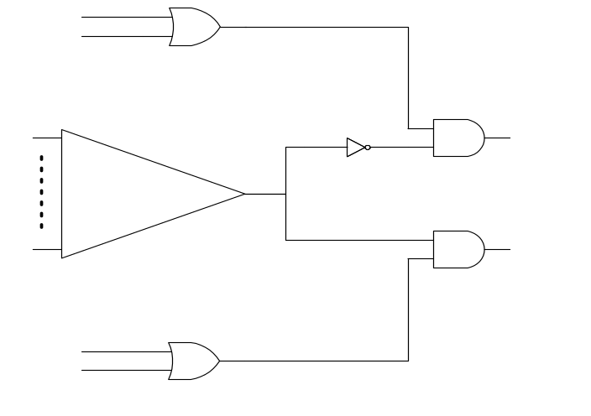
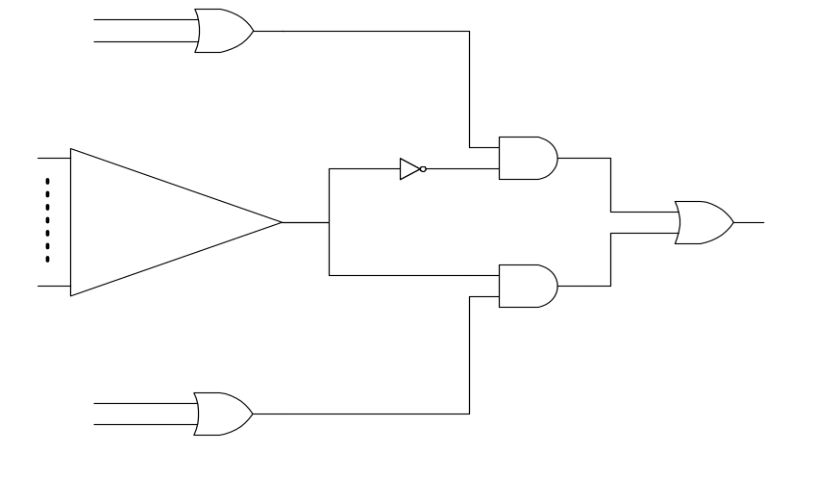
Trapped Inverters
Non-reconvergent fan-out
Reconvergent fan-out : cone_{i} must be duplicated
inv_{i}
O₂
cone_{i}
N_{i}
O₁
inv_{i}
cone_{i}
N_{i}
O

Slide 5
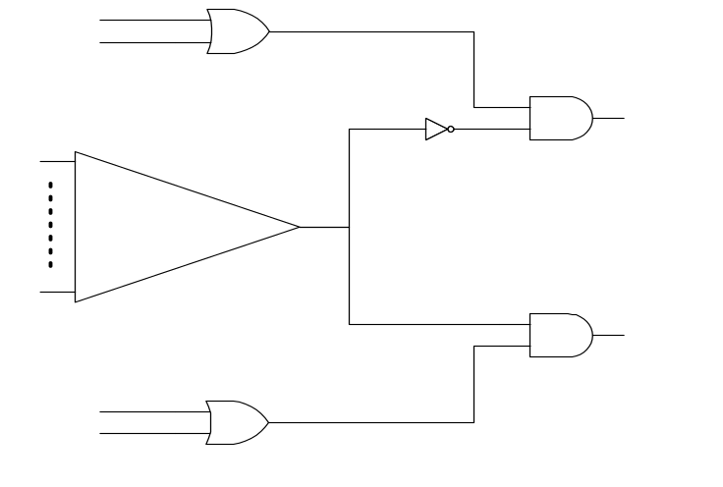
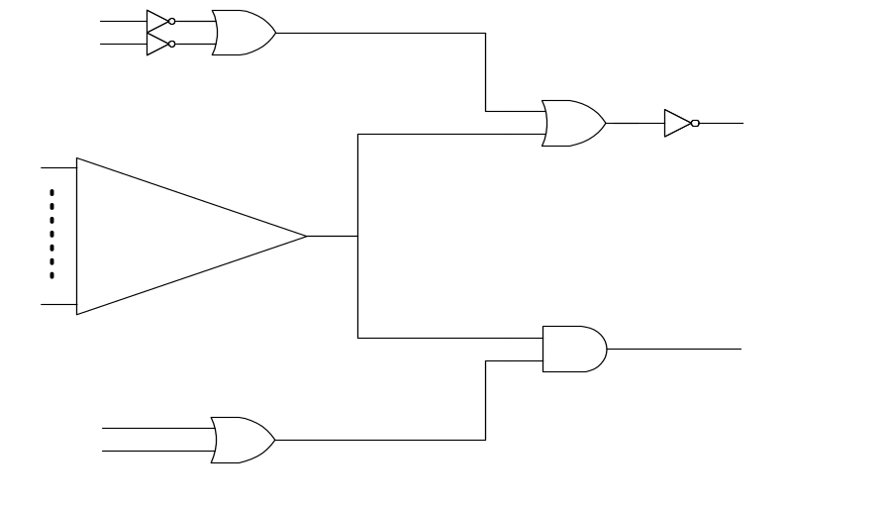
Output Phase Assignment
Remove trapped inverter in non-reconvergent fan-out
inv_{i}
O₂
cone_{i}
N_{i}
O₁
O₂
cone_{i}
N_{i}
O₂ : Negative Polarity
O₁ : Positive Polarity
O₁

Slide 6
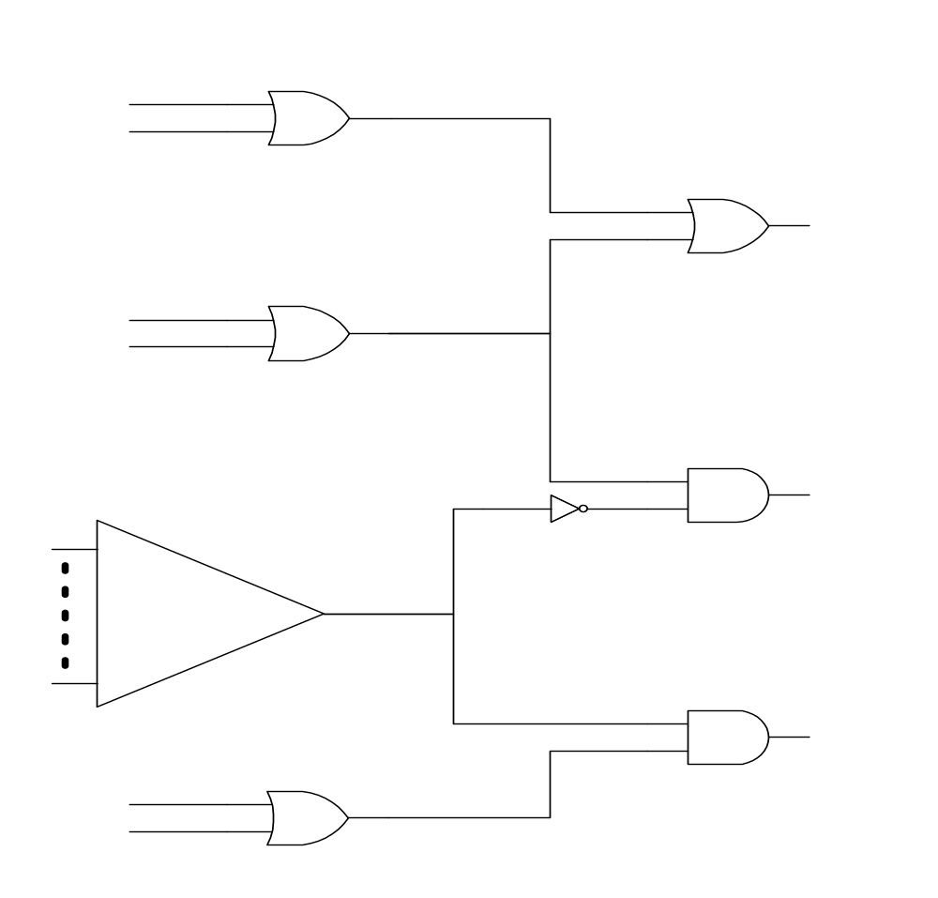
Conflicting Output Phase
O₃
O₂
O₁
Conflicting requirement for output O2

Slide 7
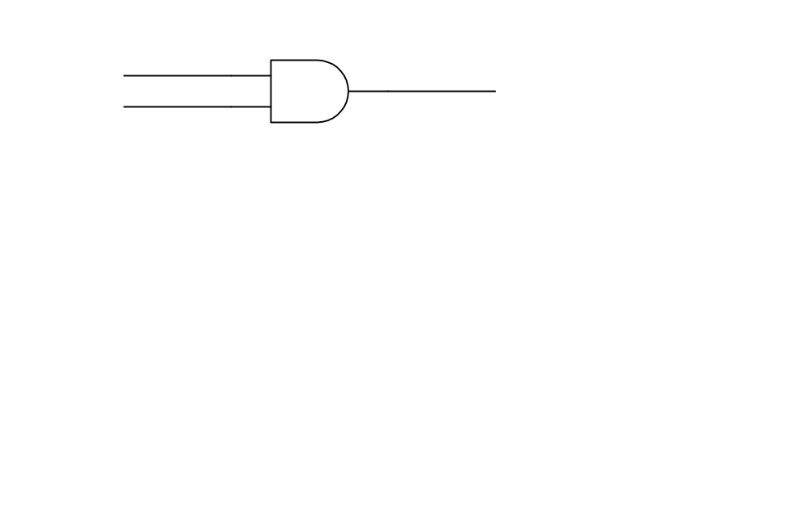
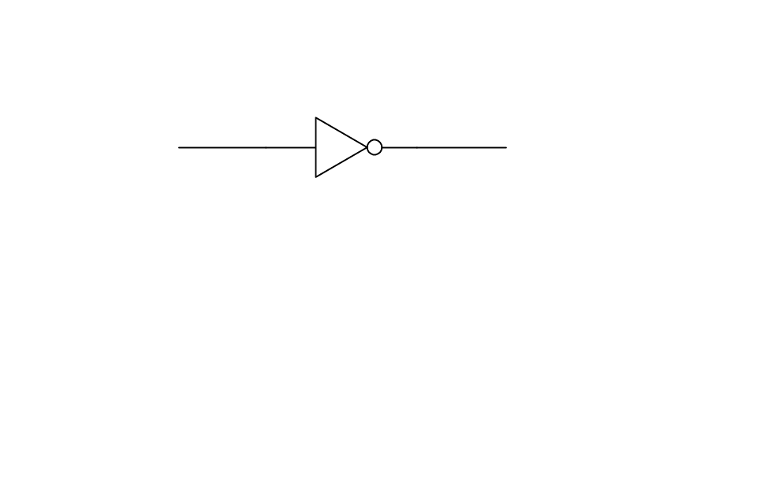
Computing the Polarity of Outputs for
Fan-out Net
From output to input
Initially, for each Oj :
  [ – – v_{j} = P – – ]
Propagating AND/OR gate :
  vector remains the same
Propagating NOT gate :
  vector is complemented
[− P −]
[− P −]
[− P −]
[− N −]
[− P −]

Slide 8
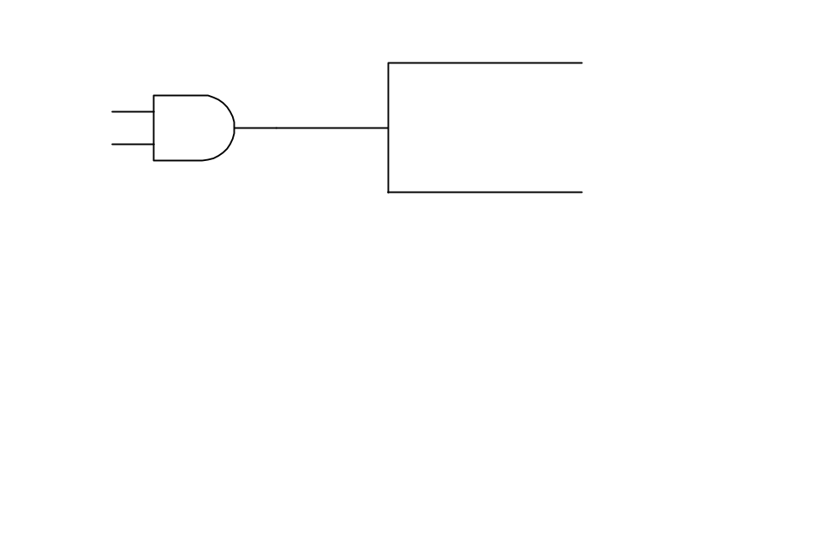
Computing the Polarity of Outputs for
Fan-out Net
Fan-out net :
  combine vectors
[N P −]
[N P N]
[N − N]

Slide 9
Example
[− − P]
[− − P]
[− − P]
O₃
[− P P]
[− P −]
[− P −]
O₂
[− N −]
[− P −]
[P N −]
[P − −]
O₁
[P − −]

Slide 10
Trapped Inverter at Reconvergent Fan-out
Combine vector for one fan-out
Trapped inverter at re-convergent fan-out
⇒ need duplication of fan-in cone of Net 1
[ P N − ]
Net1
[ N − P ]

Slide 11
Trapped Inverter at Non-reconvergent Fan-out
After assignment for all fan-out Net
  Net 1 : [ N P N ]
  Net 2 : [ P P N ]
Conflicting requirement of Output 1
  ⇒ trapped inverter at non-reconvergent fan-out
  ⇒ need duplicating fan-in cone of Net 1 or fan-in cone of Net 2

Slide 12
Model the Minimum Duplication Problem
N₁ : [ P P – ]
N₂ : [ N – P ]
N₃ : [ P – P ]
N₄ : [ – N P ]
Model the constraints as 2-SAT formula :
(N₁+N₄) (N₁+N₂) (N₂+N₃)
If a variable evaluates true, its fan-in cone is duplicated.
N₁
N₂
N₄
N₃

Slide 13
Removal of Trapped Inverter
Use technique of redundancy addition and removal
Make trapped inverter redundant by adding logic
Add logic close to output. If inverters are added, the added logic is implemented by CMOS logic

